Slide 1
3D Printed FlexMask V1
The following presentation is a compilation of designs, notes, and instructions for printing and assembling a FlexMask
Andrew Przyjemski
awp5357@psu.edu

Slide 2
Materials

Slide 3
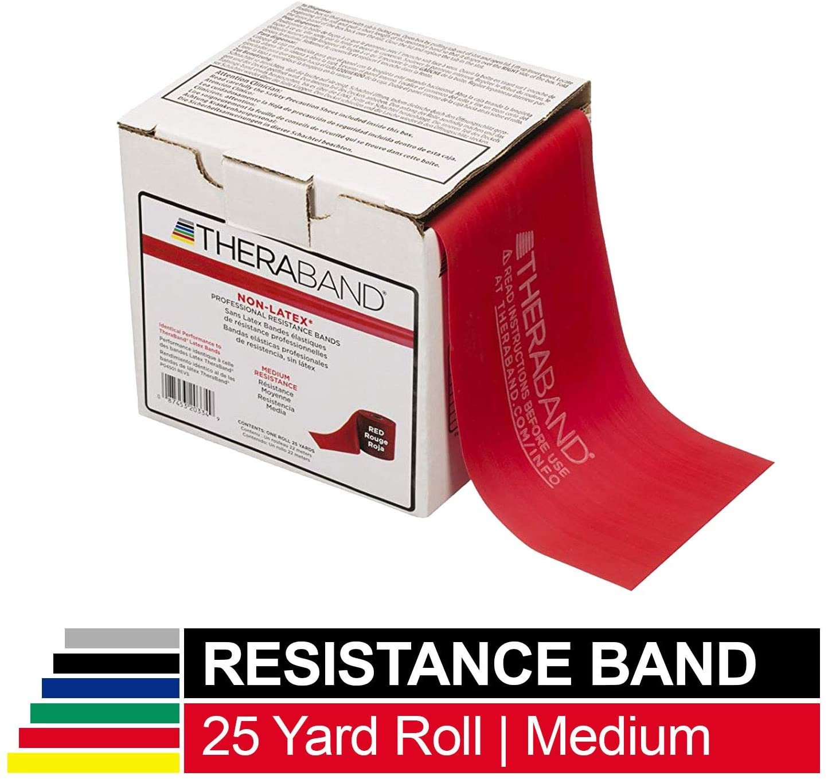
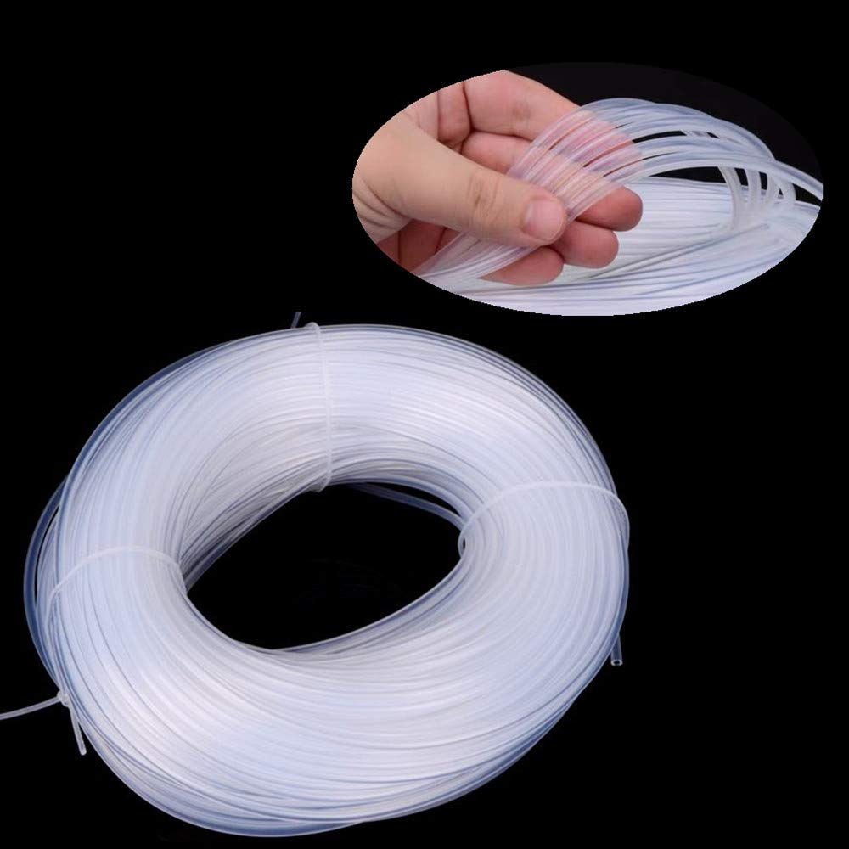
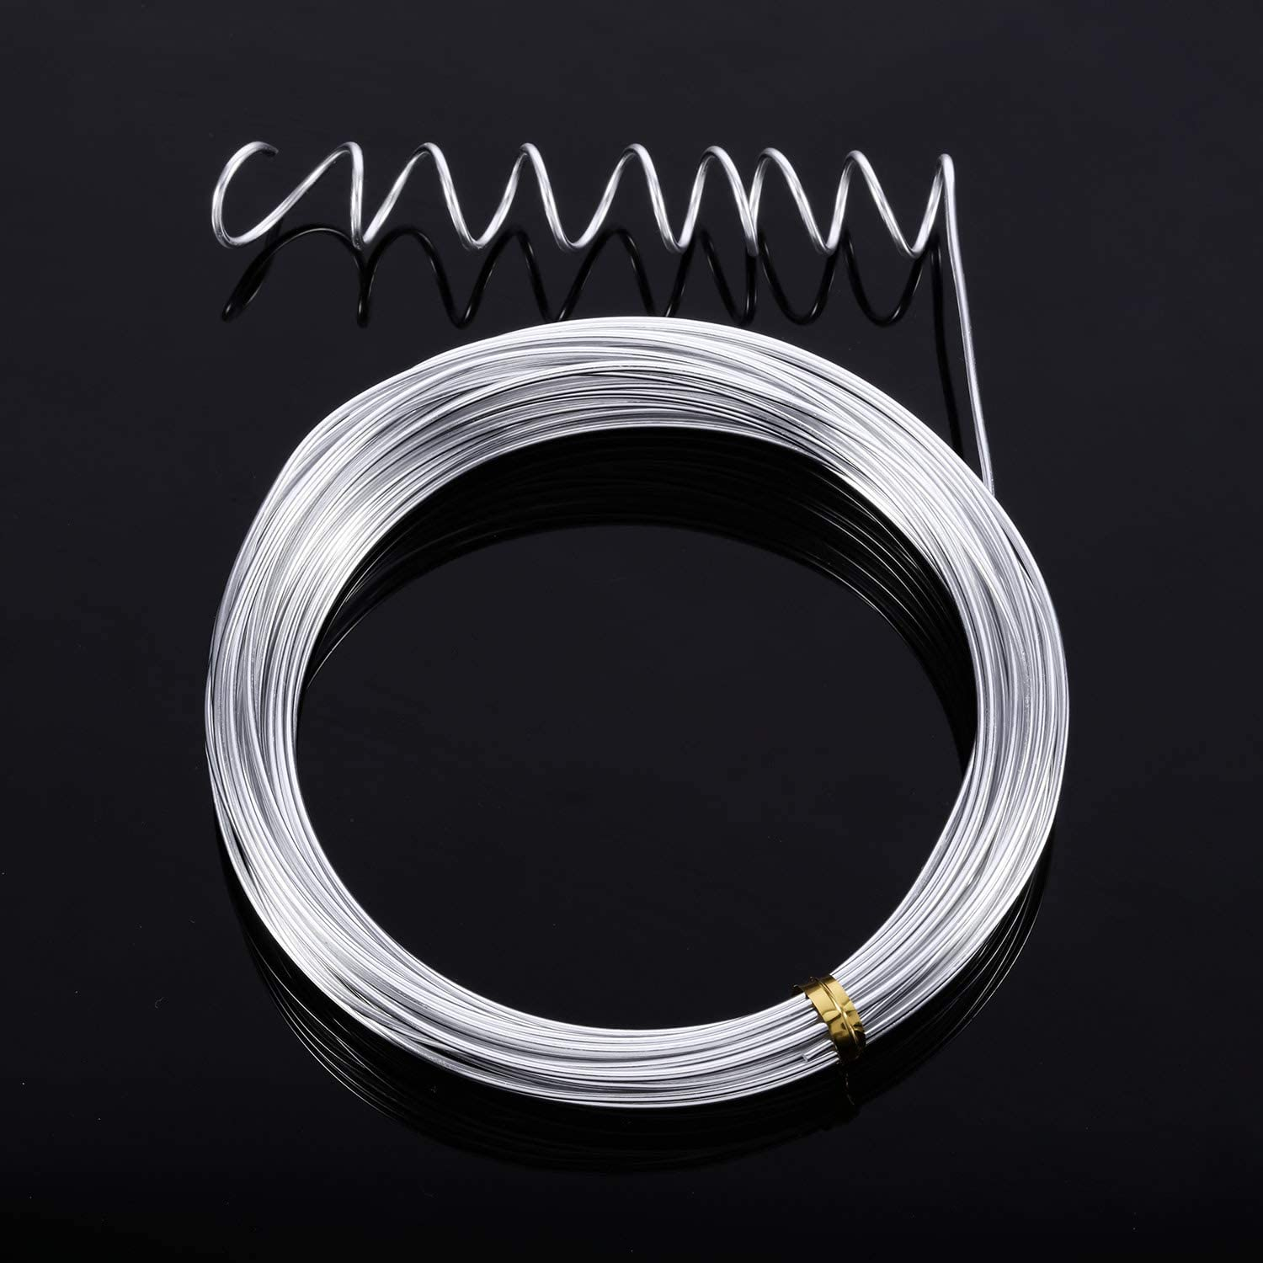
Bill of Materials
TPU95 flexible filament
540 mm of 1.5mm aluminum armature wire
Straps (examples listed below)
4mm ID x 6mm OD Silicone rubber tube
Non-latex resistance band
Other strap materials are feasible, but only the two above have been tested

Slide 4
Cost of Goods Sold (COGS)
Item | Supplier | Category | Price | Link
1.5mm x 550mm Armature wire | Animation Toolkit | Armature | $0.17 | https://tinyurl.com/yx7r4c38
Elastic cord 1/8” x 30” | Amazon | Strap | $0.04 | https://tinyurl.com/tf4ujzb
Polymaker PolyFlex 750 gram roll | Polymaker | Base | $1.80 | https://tinyurl.com/uvtl5es
Filter | ??? | Filter | ??? | ???

Slide 5
3D Printing

Slide 6
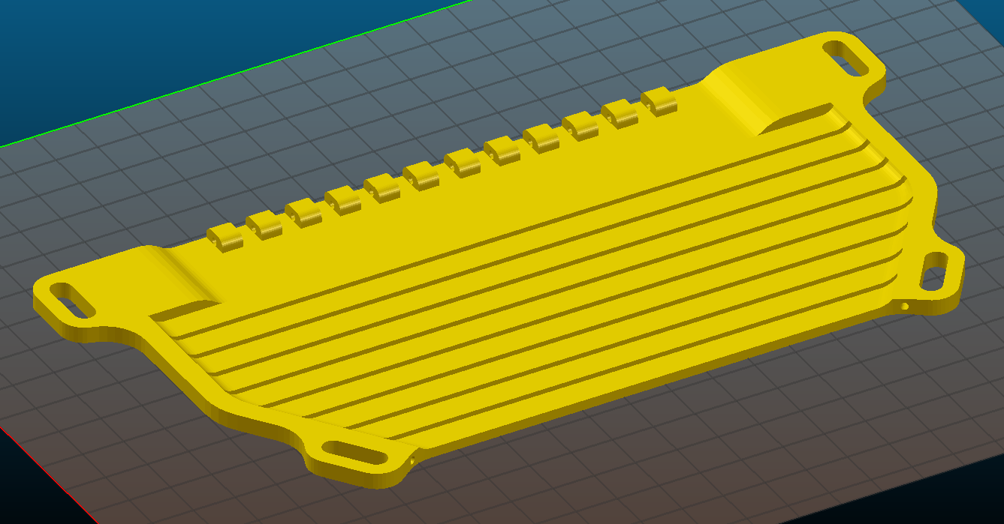
Slicing Settings
Material: Polymaker PolyFlex
Extruder: 250°C
Bed: 60°C
Layers and perimeters
Layer height: 0.3mm
# Perimeters: 2
Solid layers: 3 top and bottom
Infill
Density: 25%
Pattern: Rectilinear
Speed
20mm/s for all speed settings
Print time: ≈3 hours
Material Used: 34 grams
Print Orientation

Slide 7
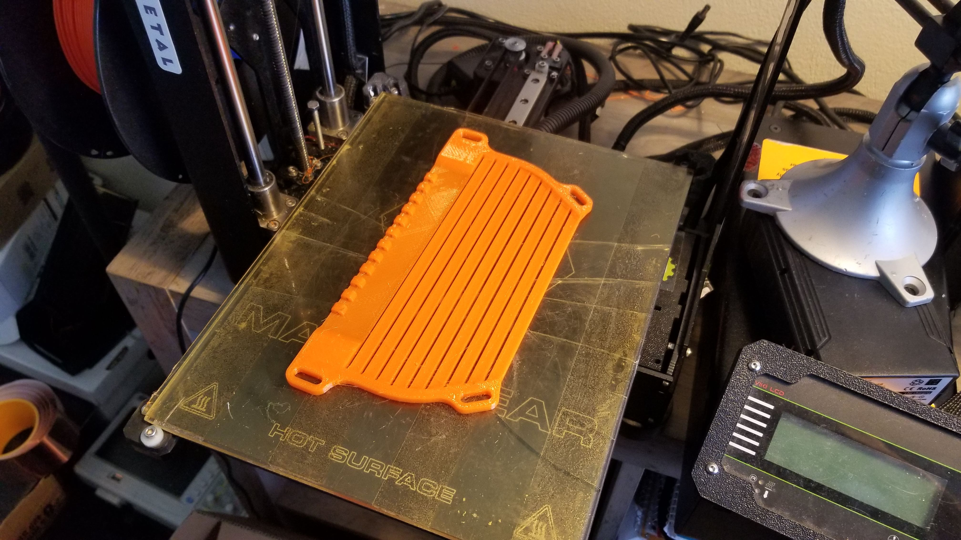
Printed Mask

Slide 8
Assembly

Slide 9
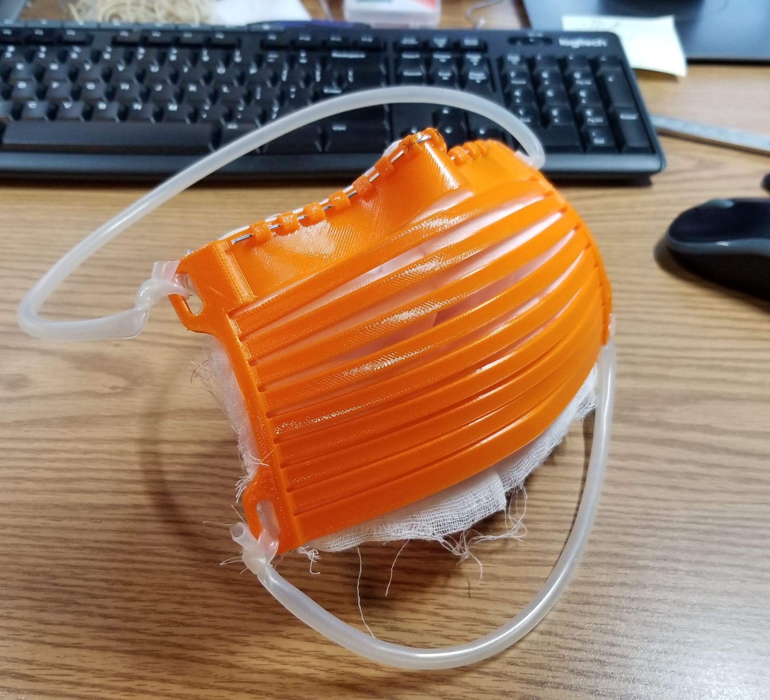
Assembly Materials
2 x (1.5mm x 210mm Al wire)
1 x (1.5mm x 120mm Al wire)
1 x 500mm strap (top)
Length may vary based on head size and strap material
1 x 330mm strap (bottom)
Length may vary based on head size and strap material
220mm x 180mm filter media
≈ 1/8” thick preferable

Slide 10
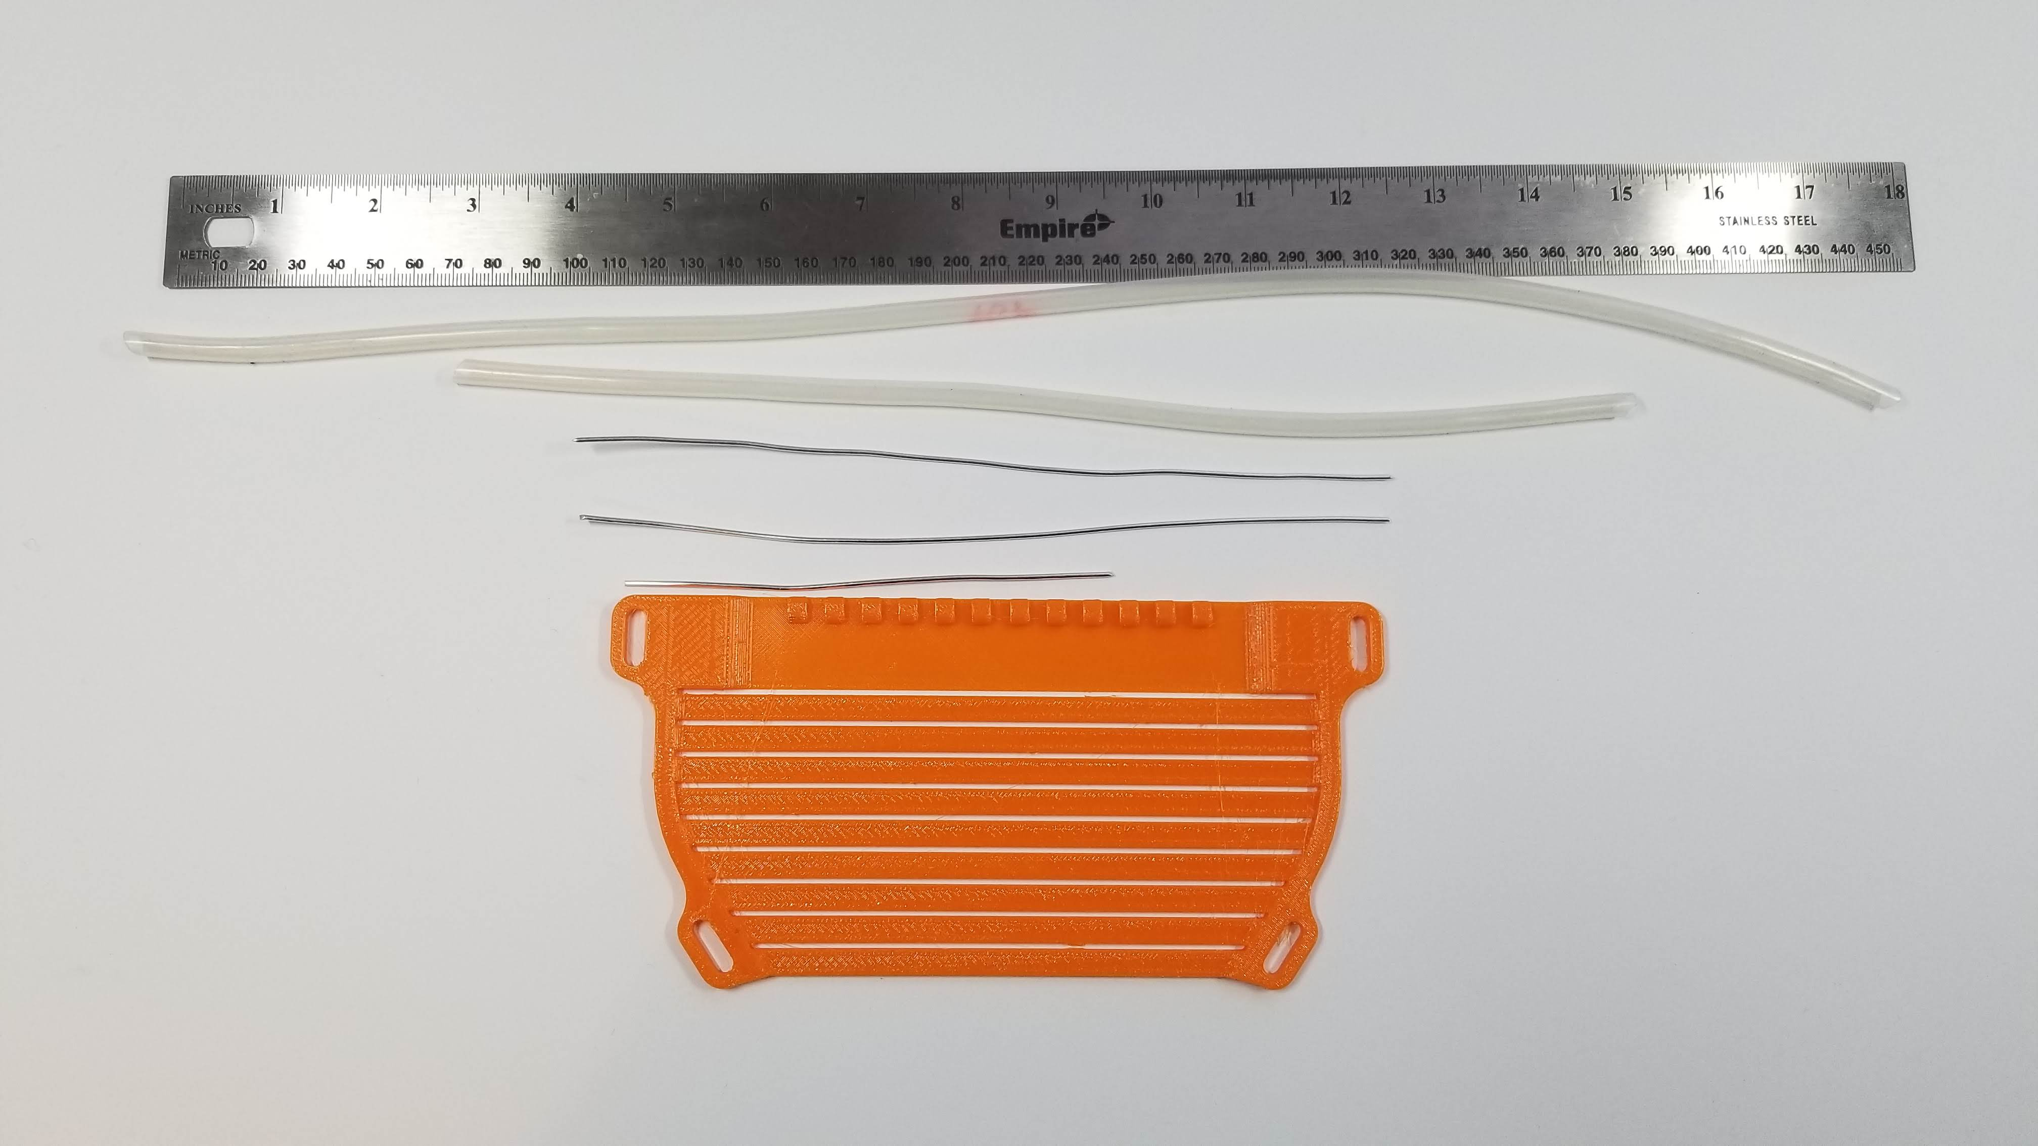
Assembly Materials

Slide 11
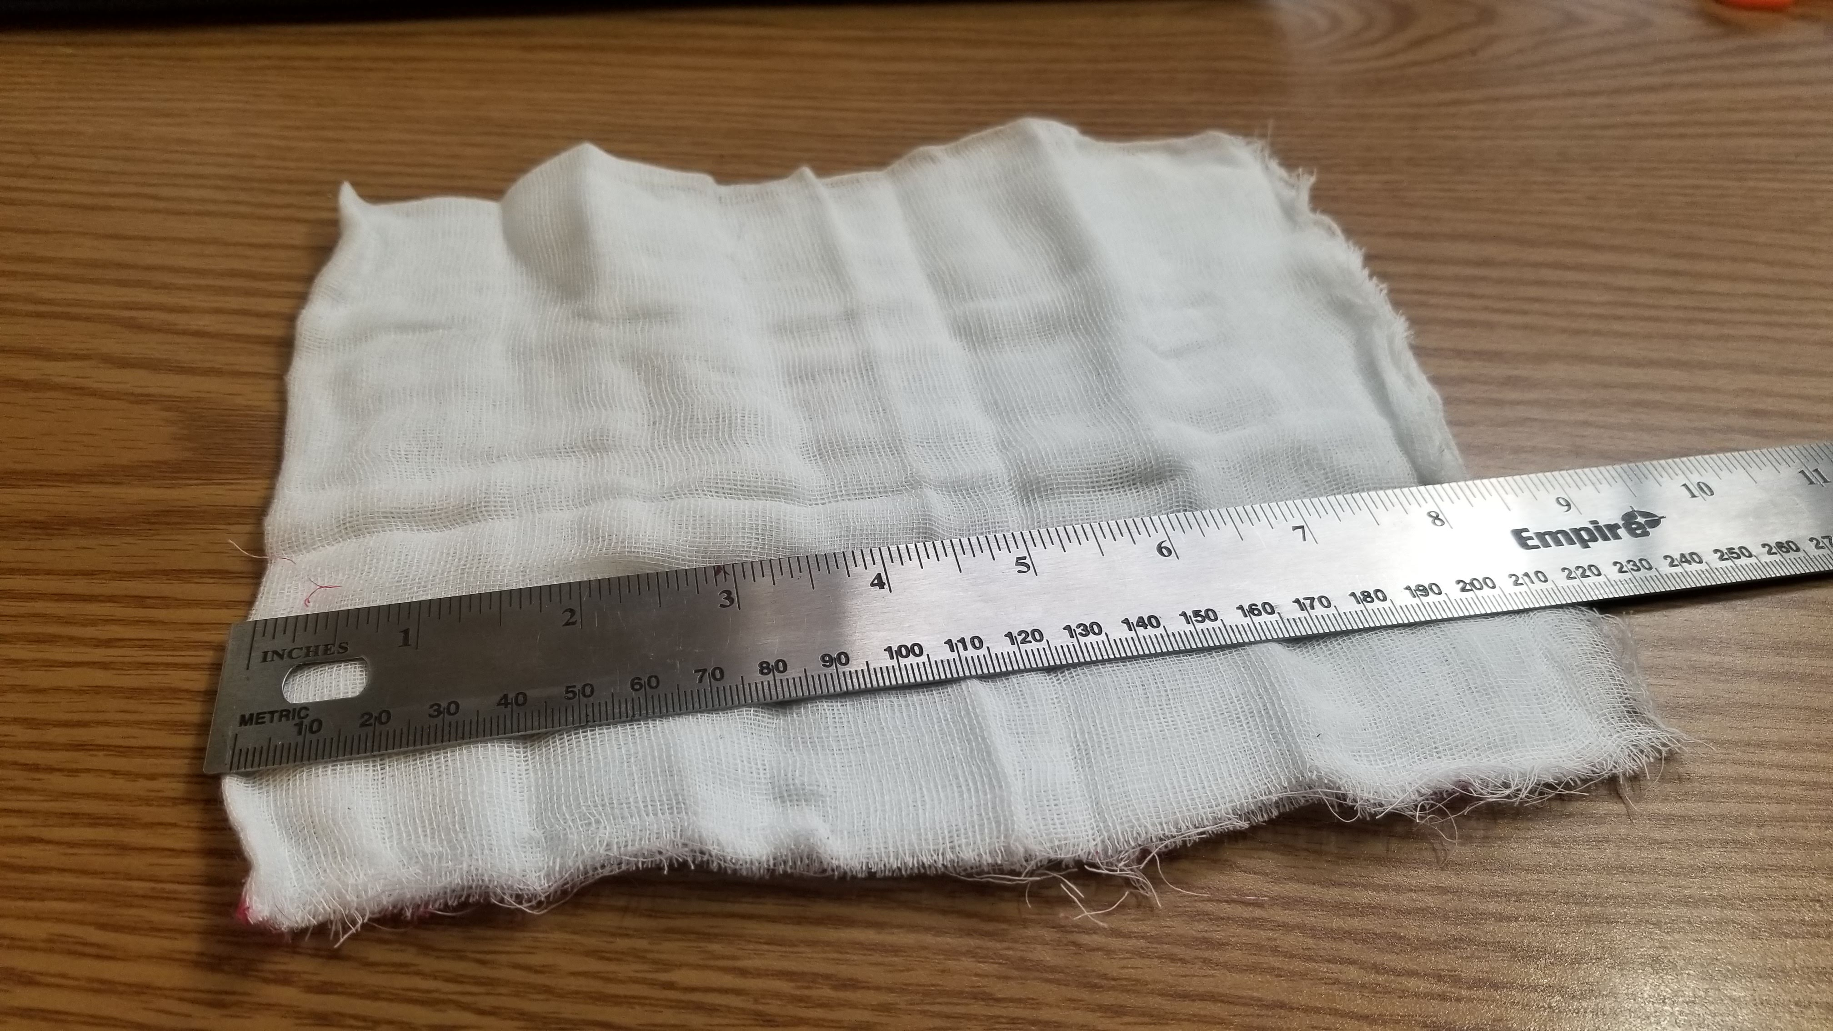
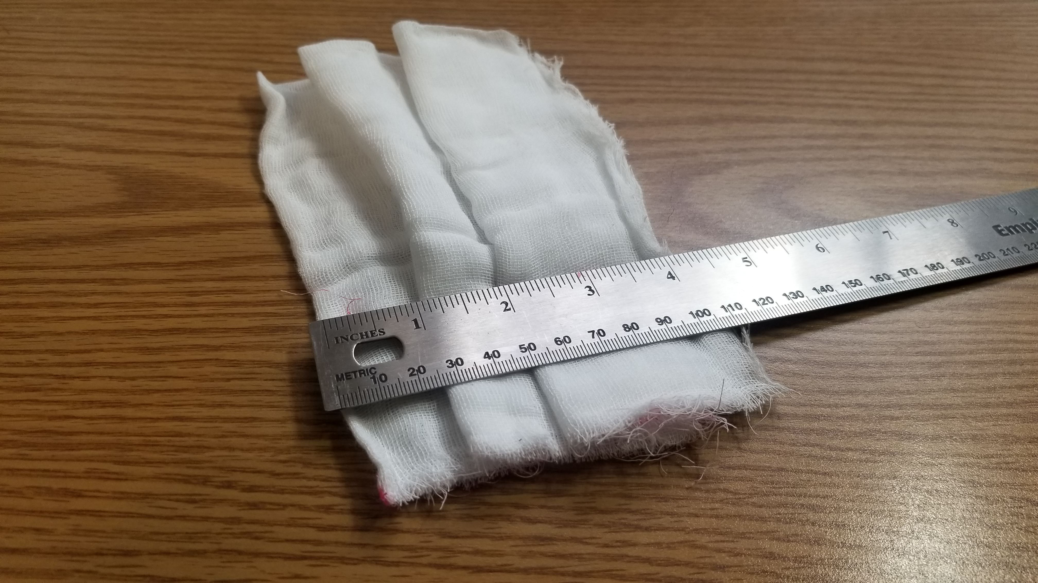
Assembly
Fold filter media along long dimension to form two pleats. Total length should be between 100 and 110mm
The filter media used in this presentation is cheesecloth and is used only for demonstration.
Cheesecloth is NOT an acceptable filter media for medical use.

Slide 12
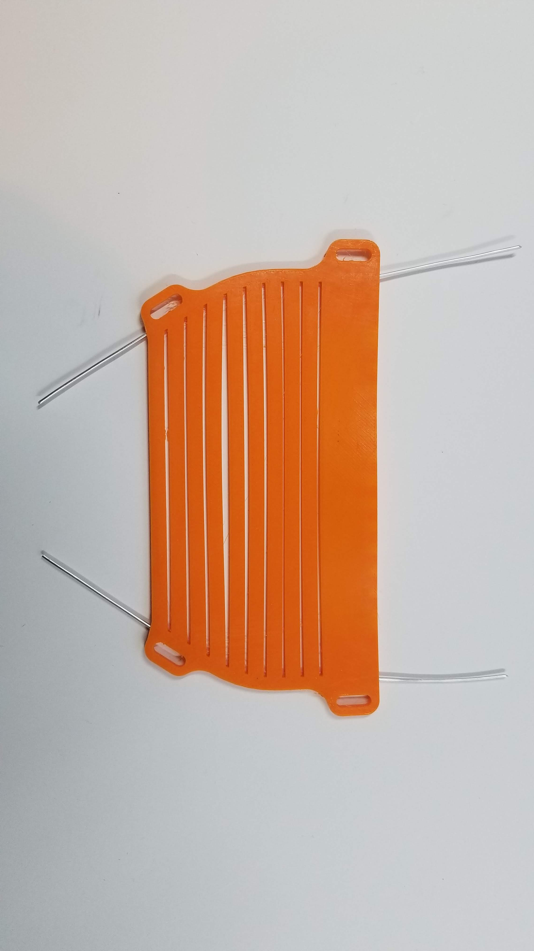
Assembly
Insert 210mm armature wires through the channel on each side of the mask, leaving 50mm at the bottom
50mm
50mm

Slide 13
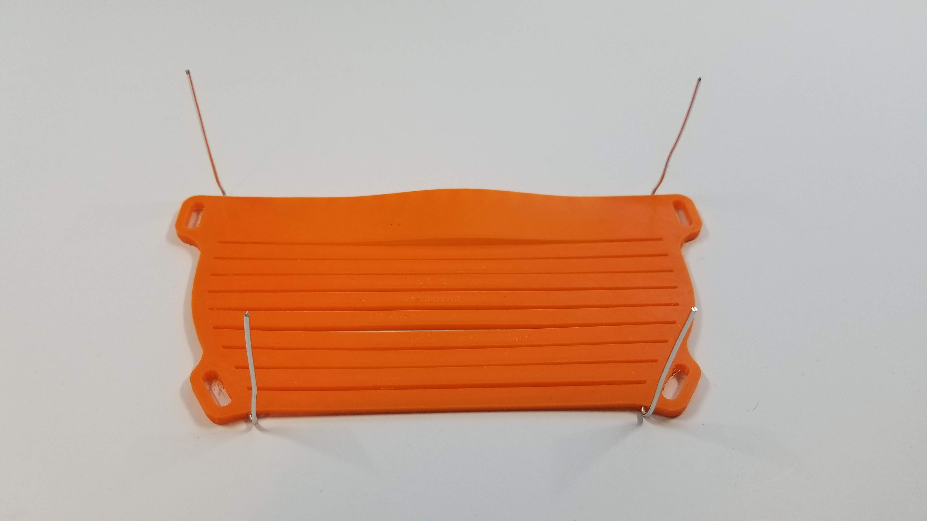
Assembly
Bend wires 90 degrees

Slide 14
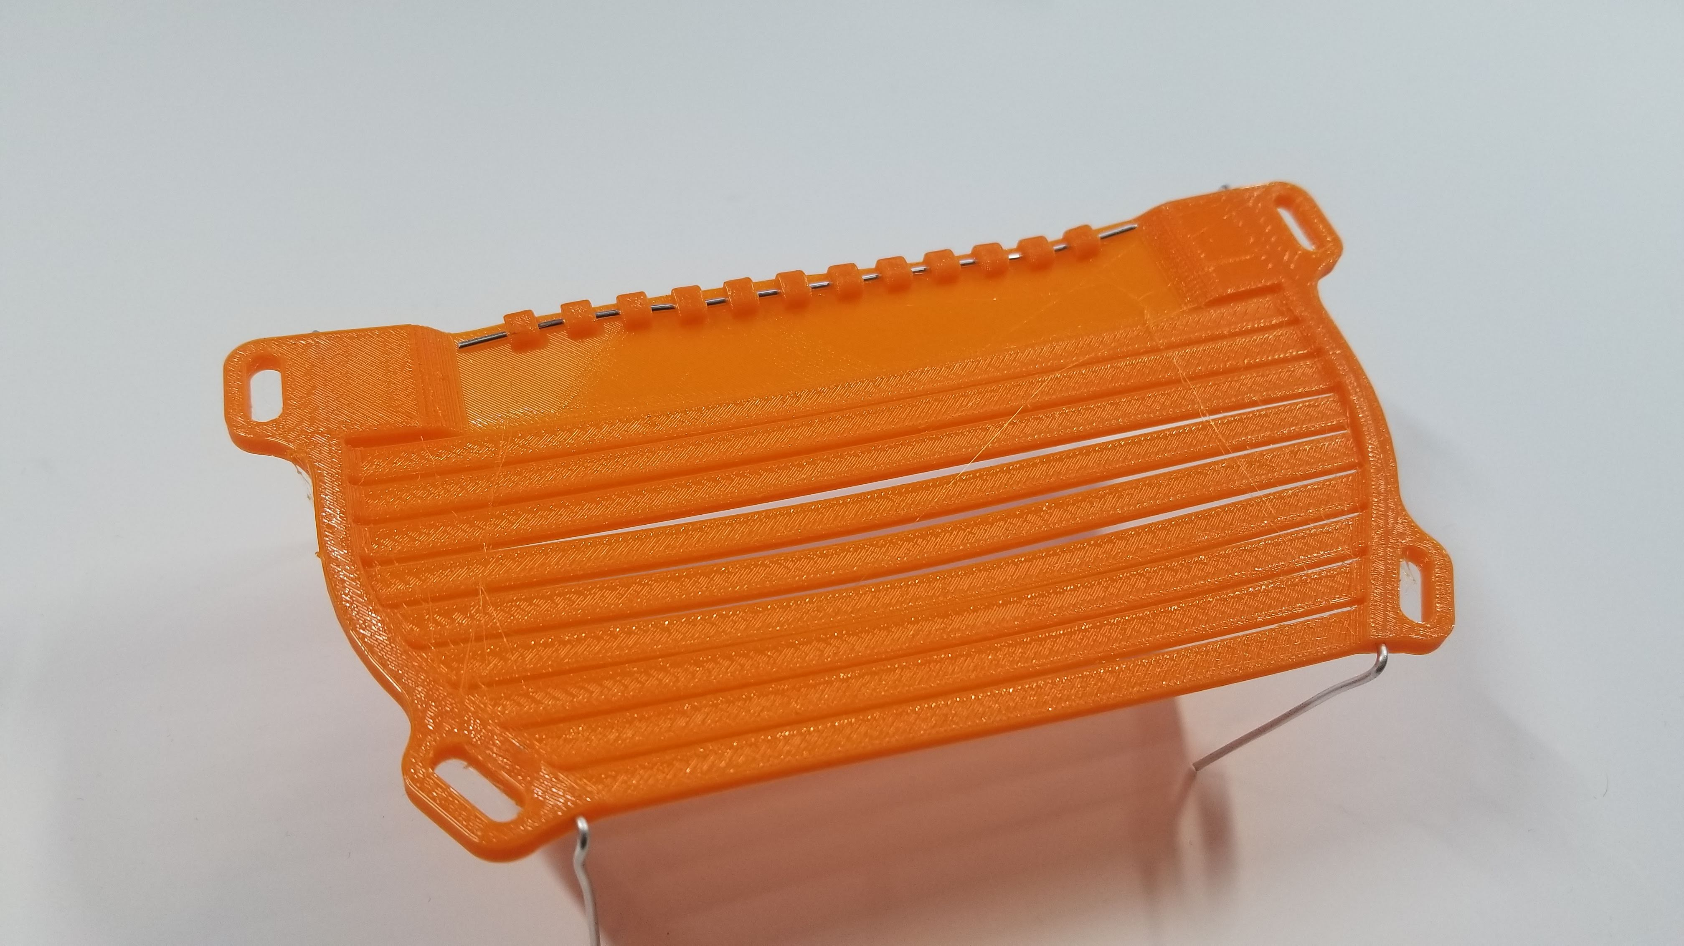
Assembly
Flip over and insert short armature wire through the channel on the nose bridge

Slide 15
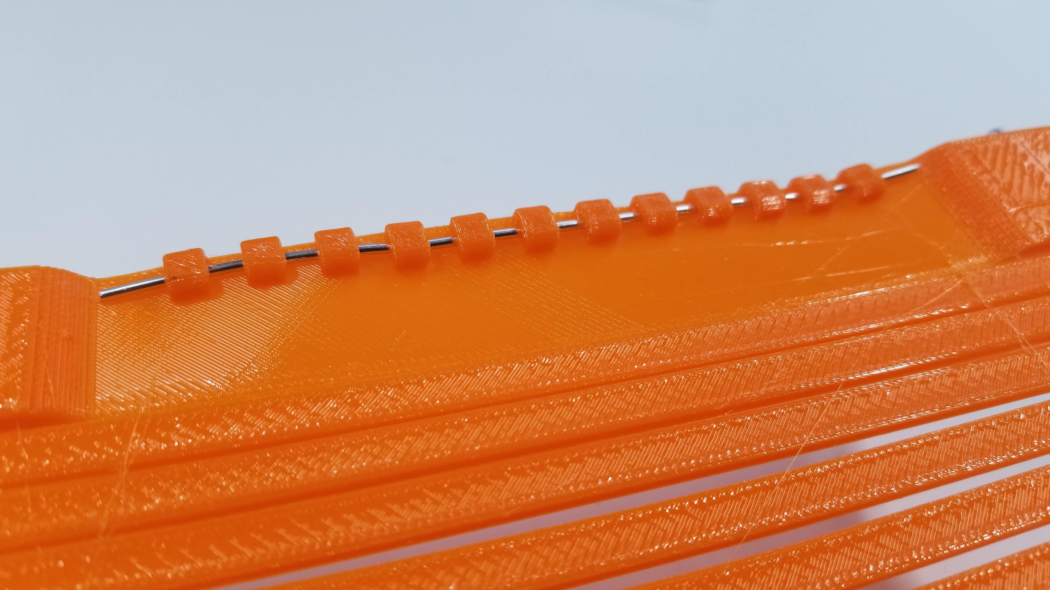

Slide 16
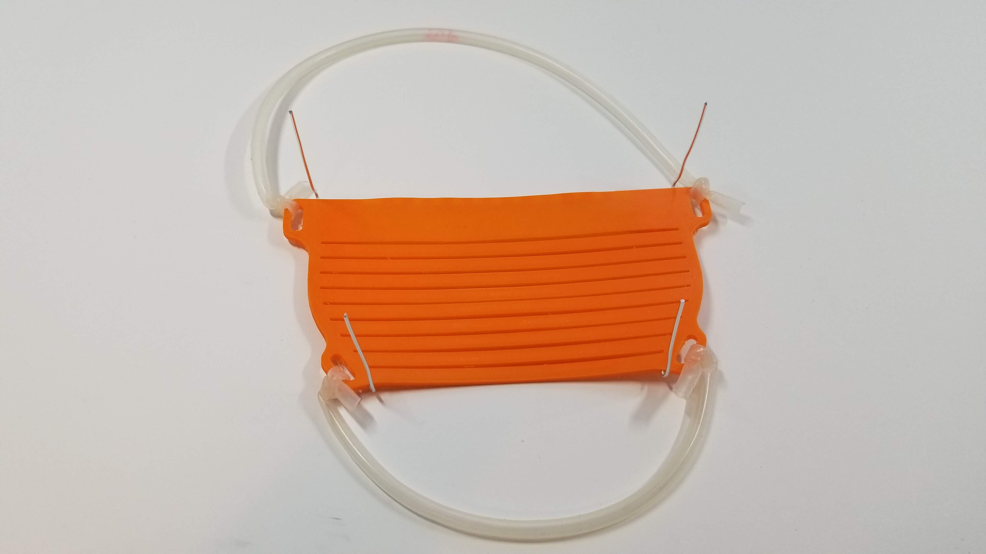
Assembly
Tie straps to each strap hole, with the longer band being tied to the top half of the mask
Top band

Slide 17
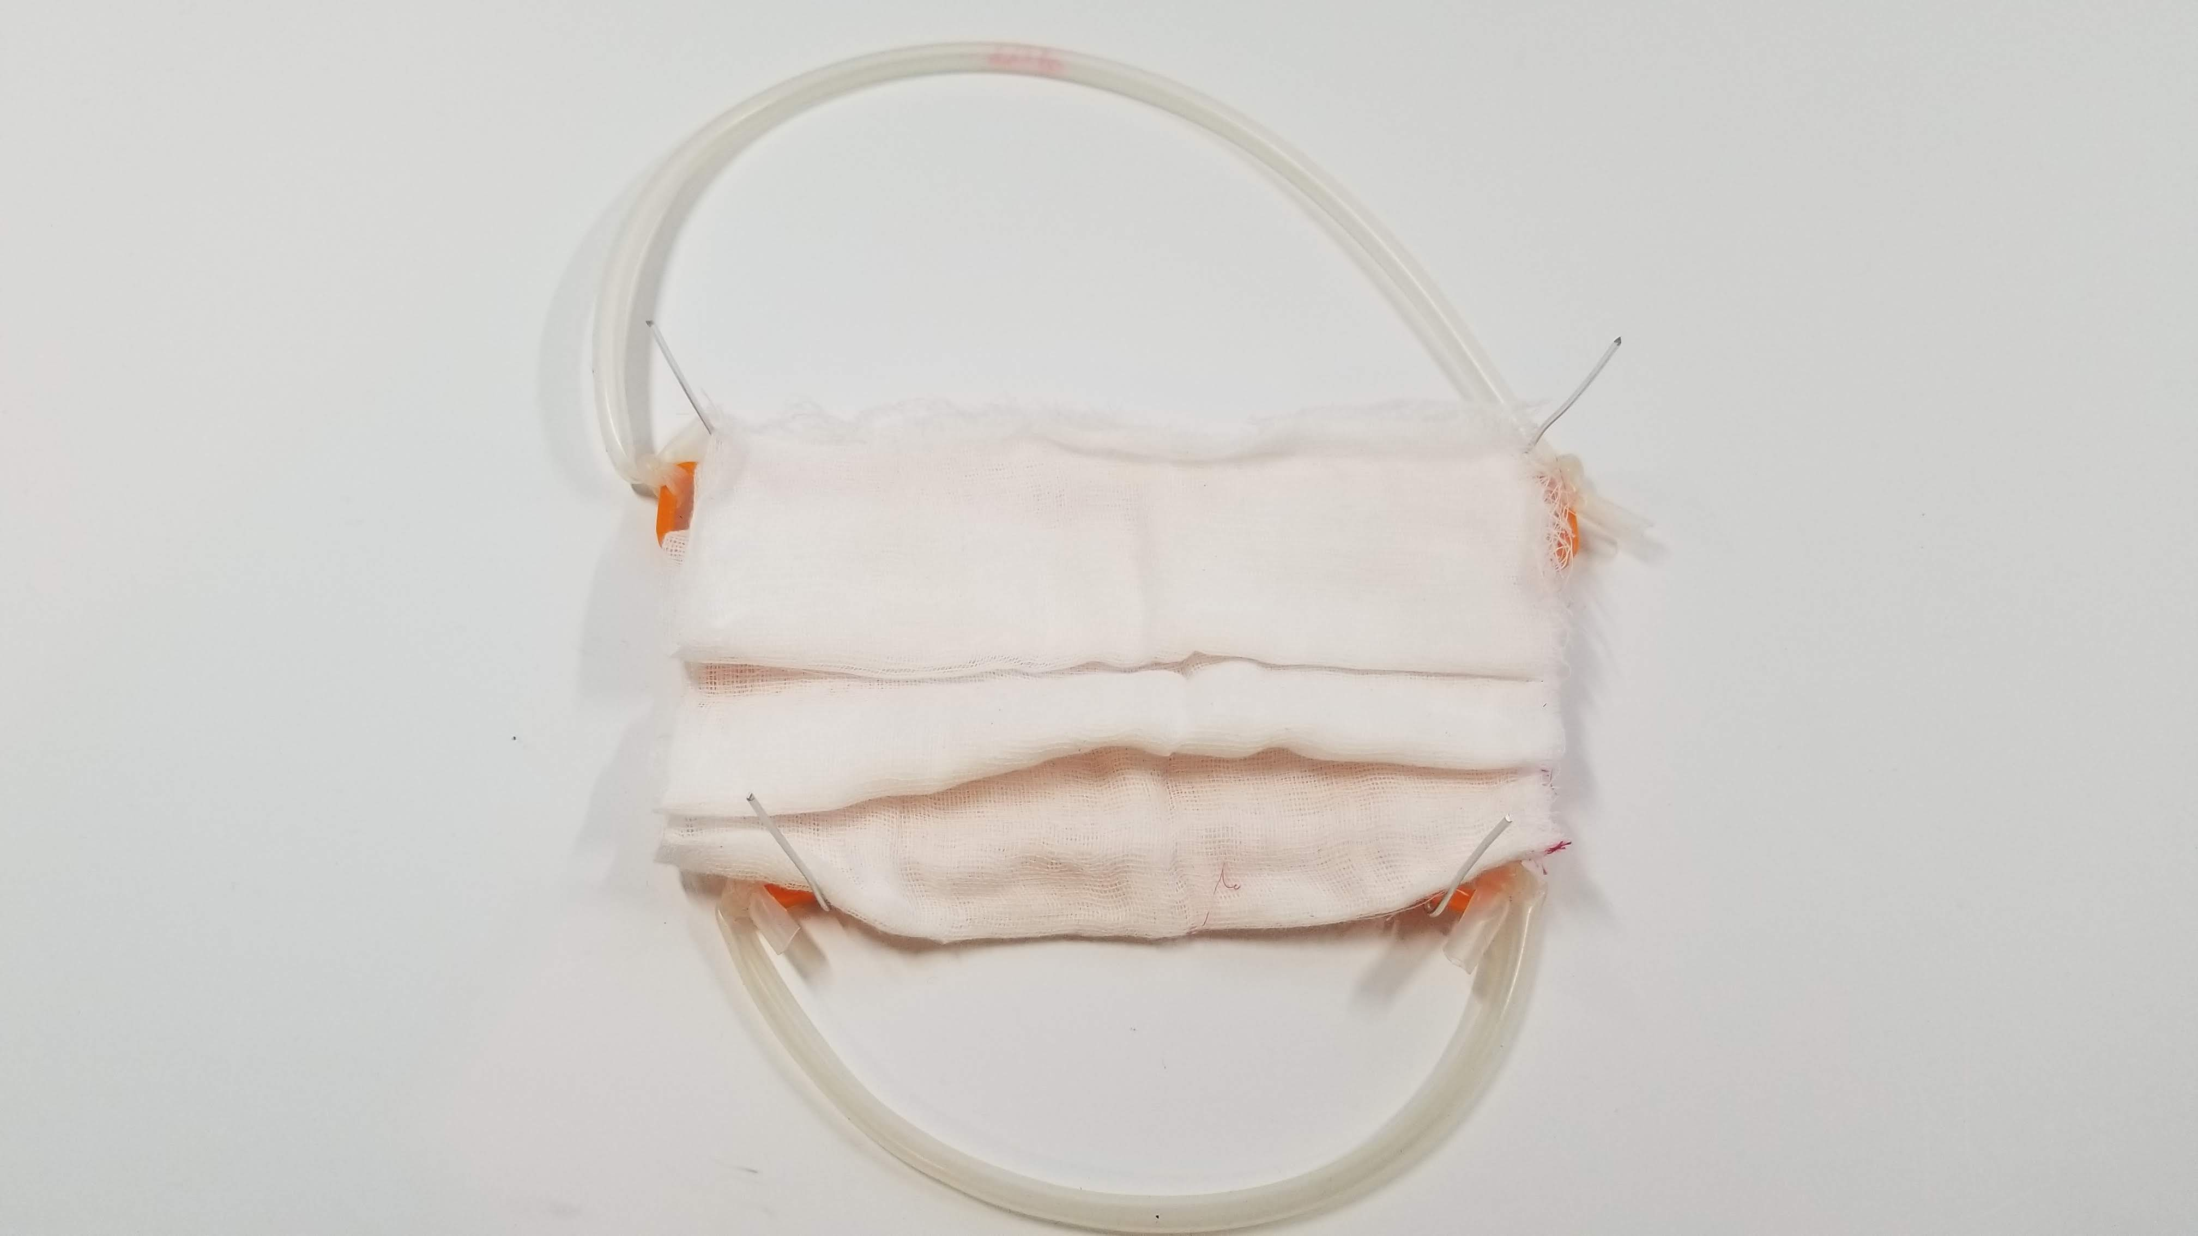
Assembly
Place pleated filter media on the back (flat side) of the mask

Slide 18
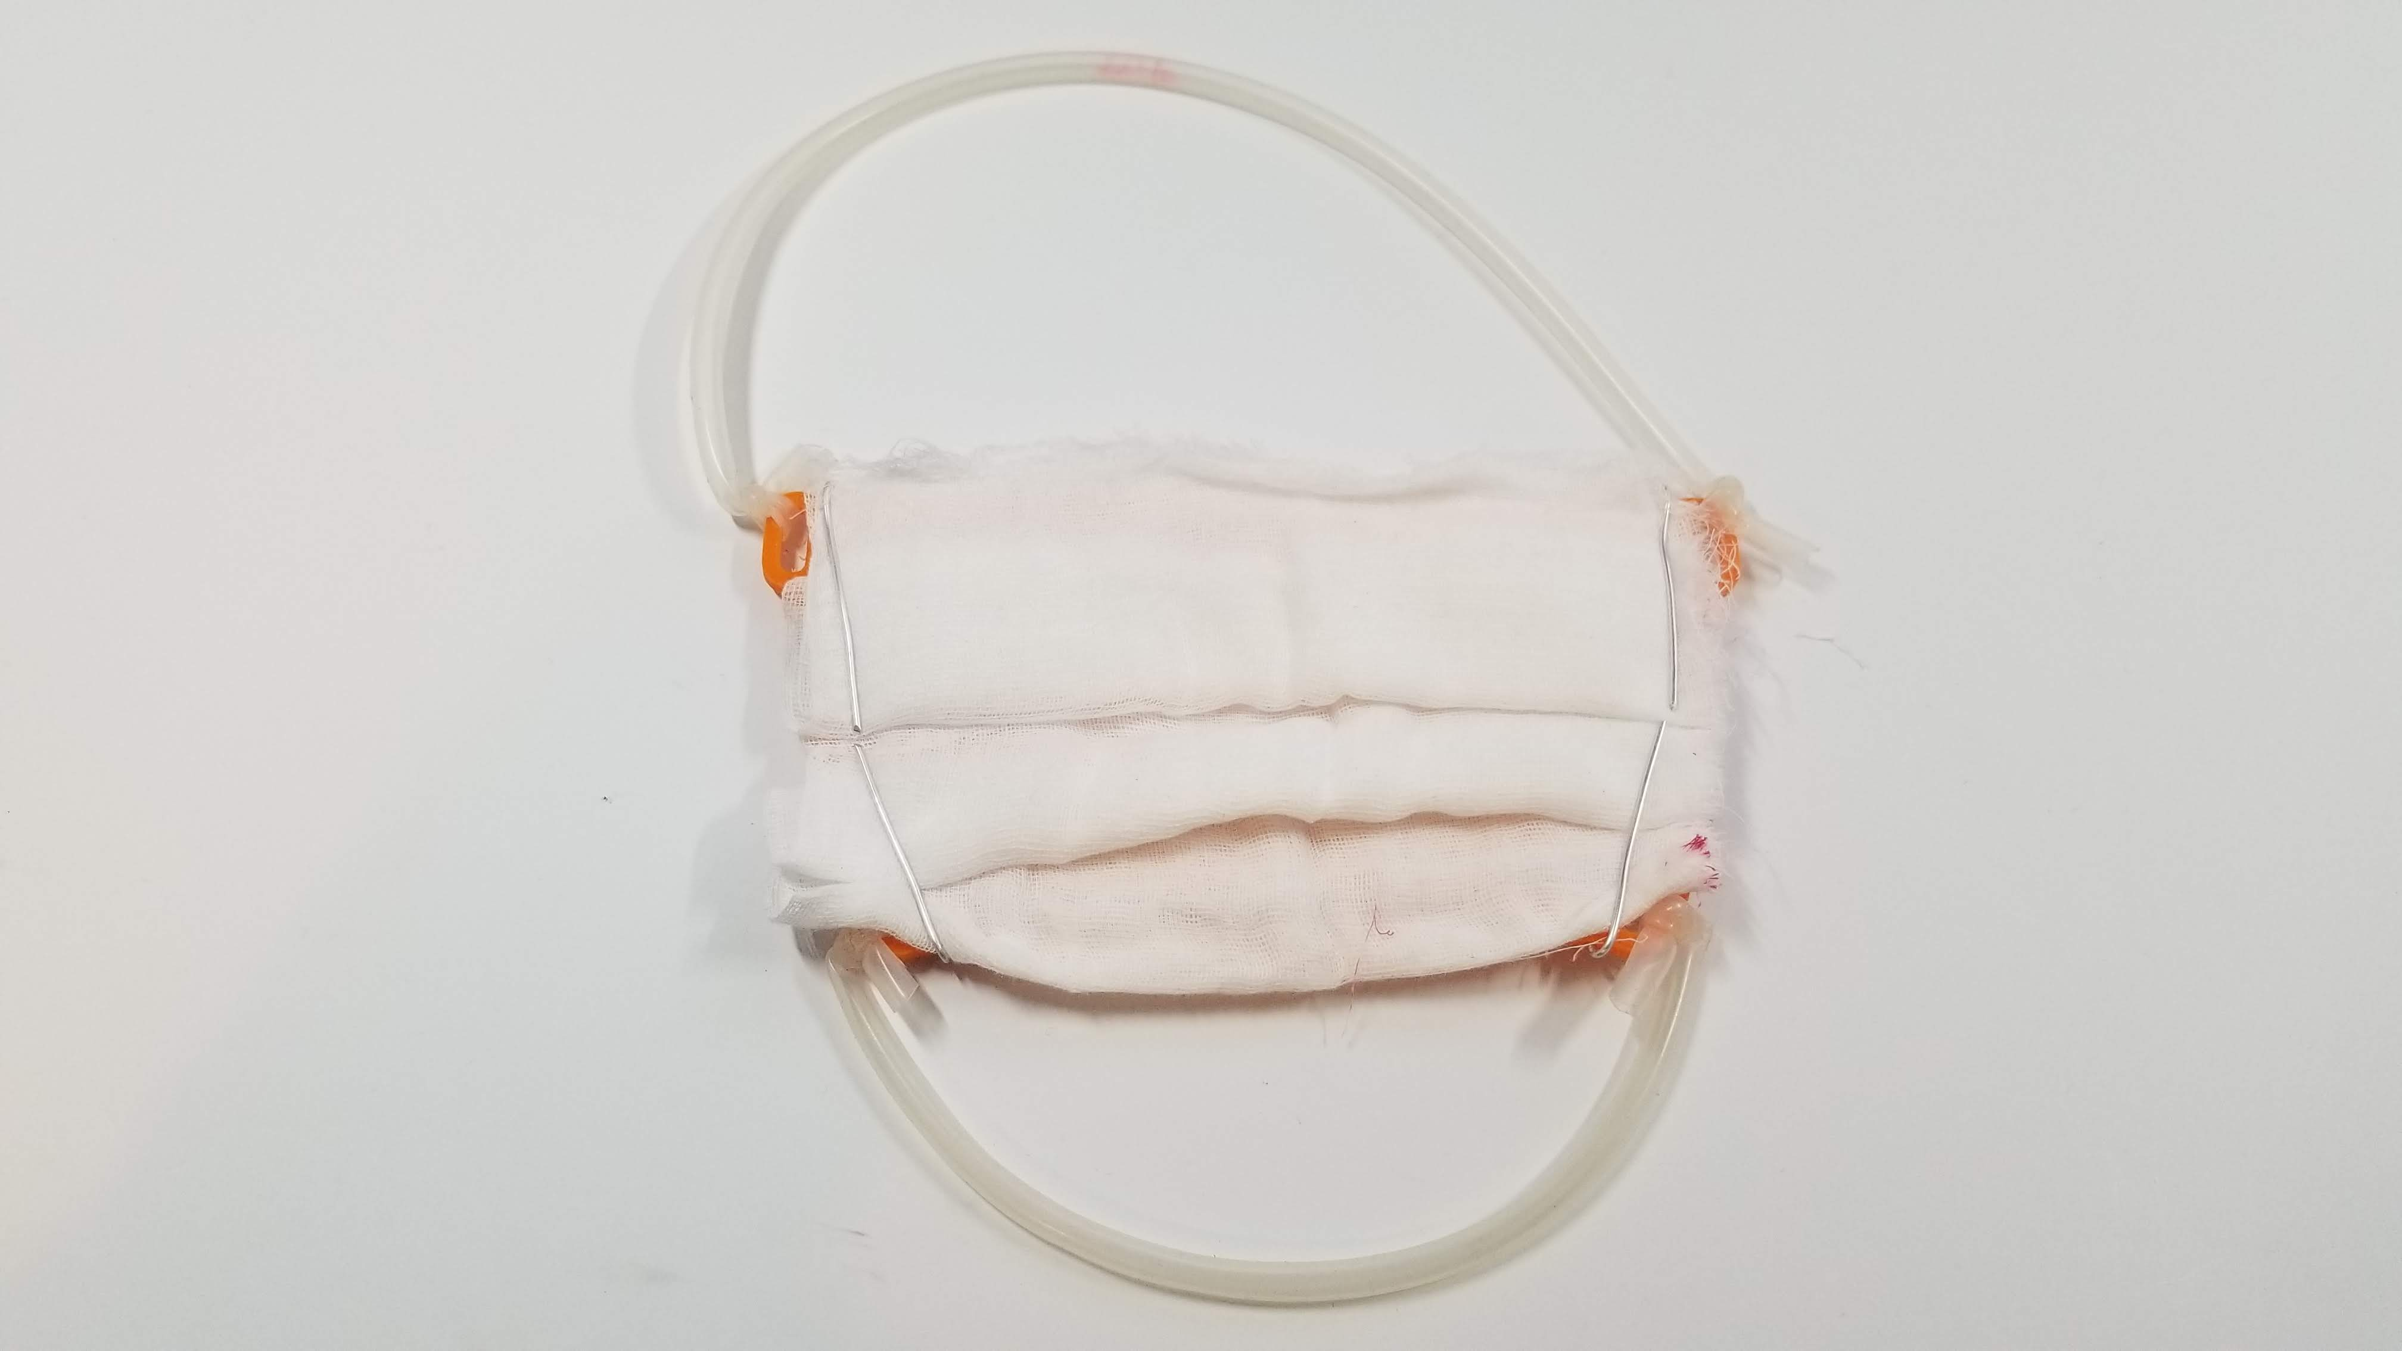
Assembly
Fold down armatures so the filter media is held in place

Slide 19
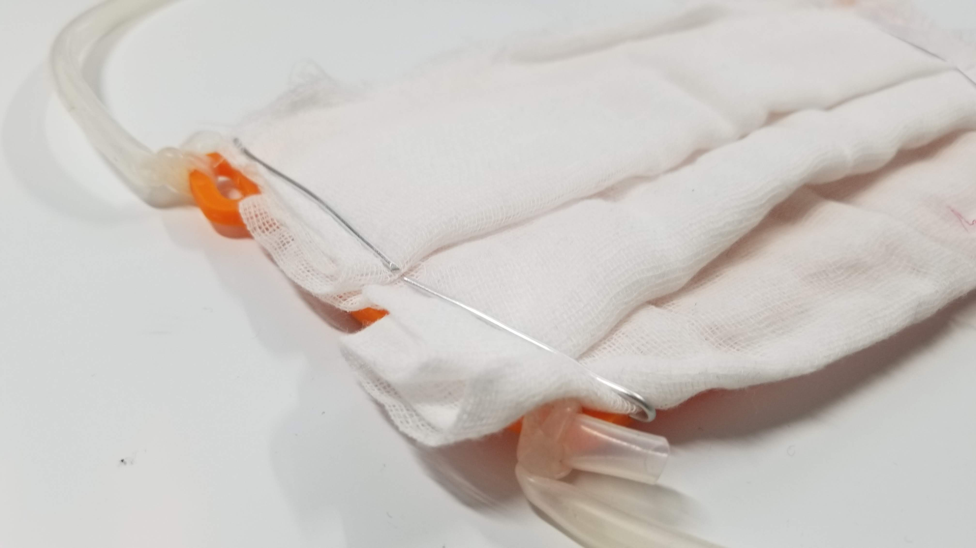

Slide 20
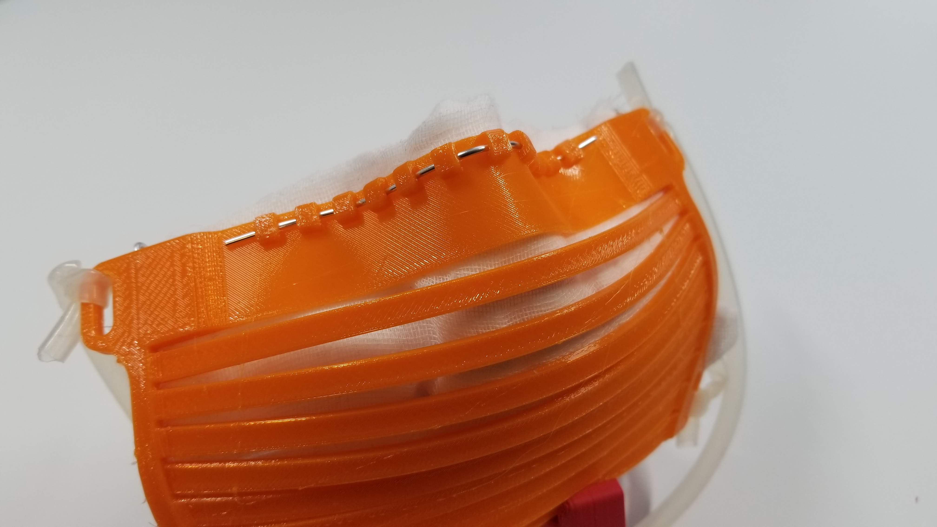
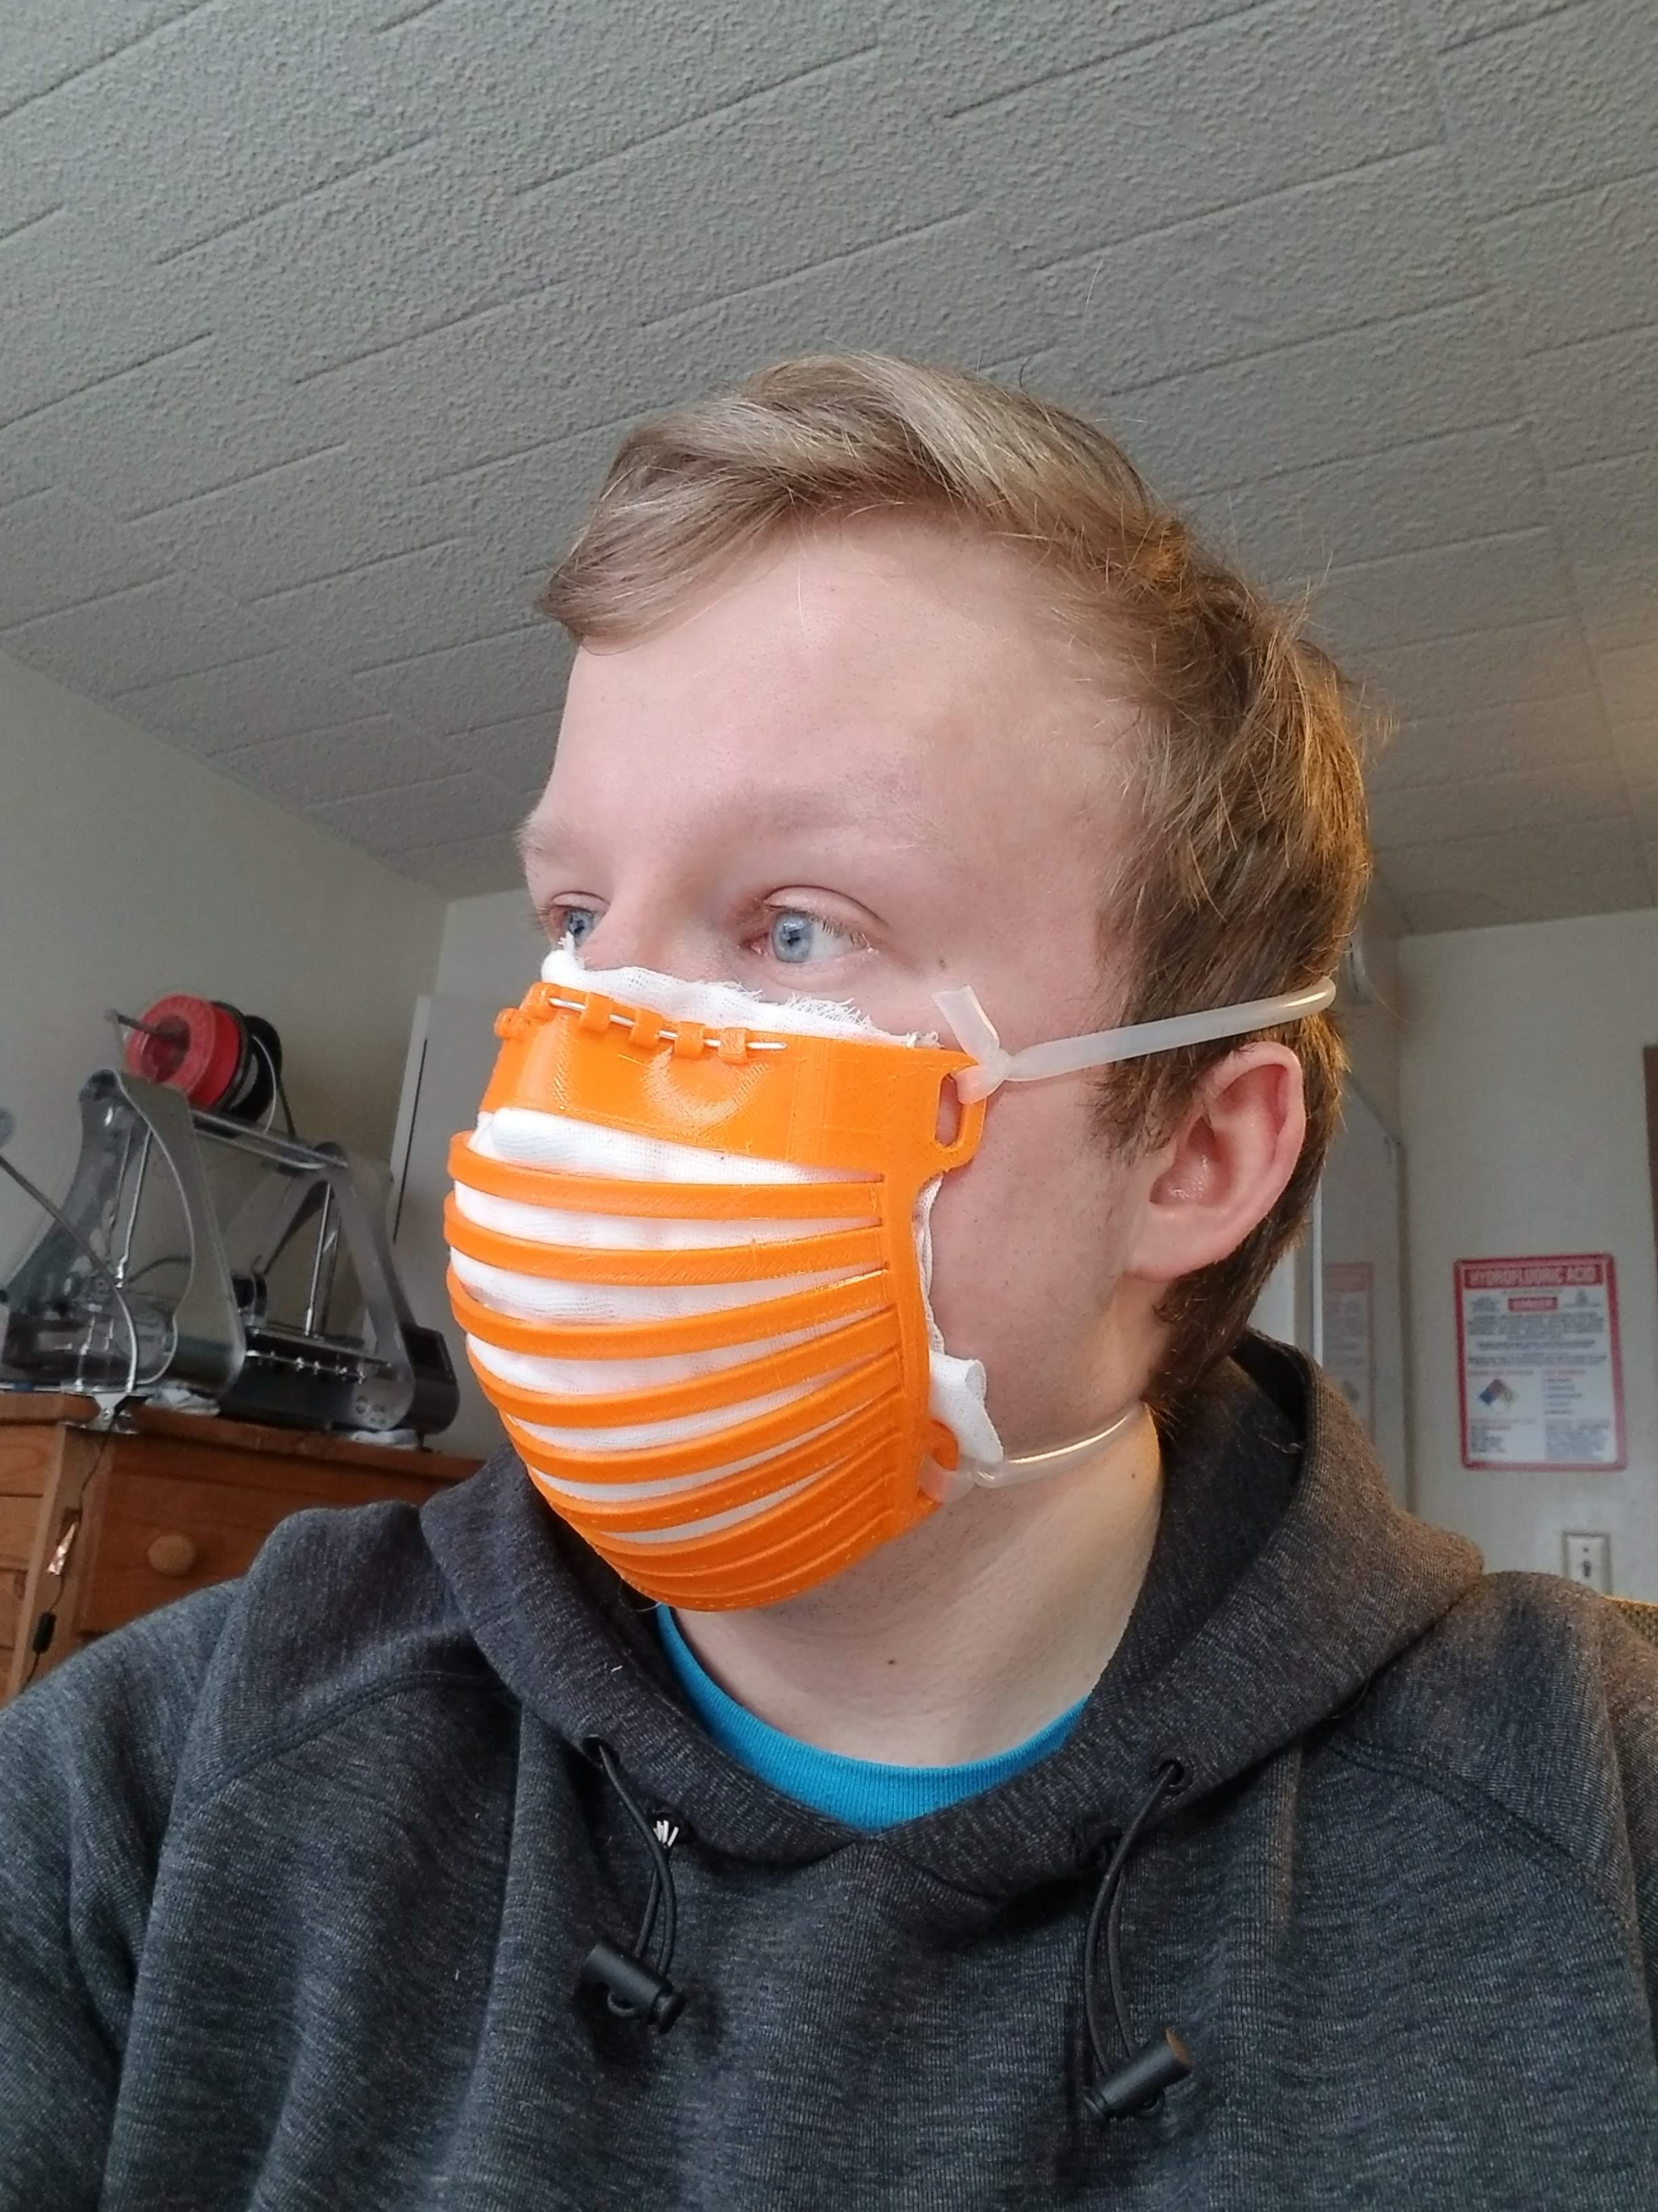
Assembly
Place on face and bend nose bridge armature to ensure proper fit

